Slide 1

Free space optical LINK DESIGN
-Falak Shah & Kavish Shah
Guided By Prof. Dhaval Shah

Slide 2
Contents
What is FSO ?
FSO v/s Fiber, RF & DSL lines
Advantage, Limitation, Application of FSO
Transmitter
Receiver
Transceiver Implementation

Slide 3
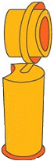



Block Diagram
Transmitter projects the carefully aimed light pulses into the air
3
A receiver at the other end of the link collects the light using lenses and/or mirrors
2
5
Reverse direction data transported the same way.
Full duplex
1
Network traffic converted into pulses of invisible light representing 1’s and 0’s
4
Received signal converted back into fiber or copper and connected to the network

Slide 4
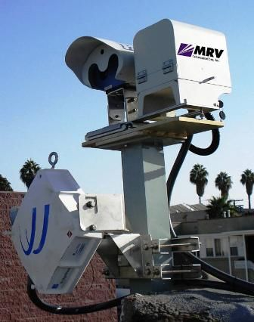
Practical Setup
Cable-free optical communication system
LOS
The first-ever 10-Gbit/sec FSO link was deployed for The Post Group, a Hollywood post-production company The Post Group went with the highest speed available, MRV Communications’ Tele-Scope 10GE. System Support Solutions, based in the Twin Cities area of Minnesota, conducted the installation. Feb 12, 2010

Slide 5
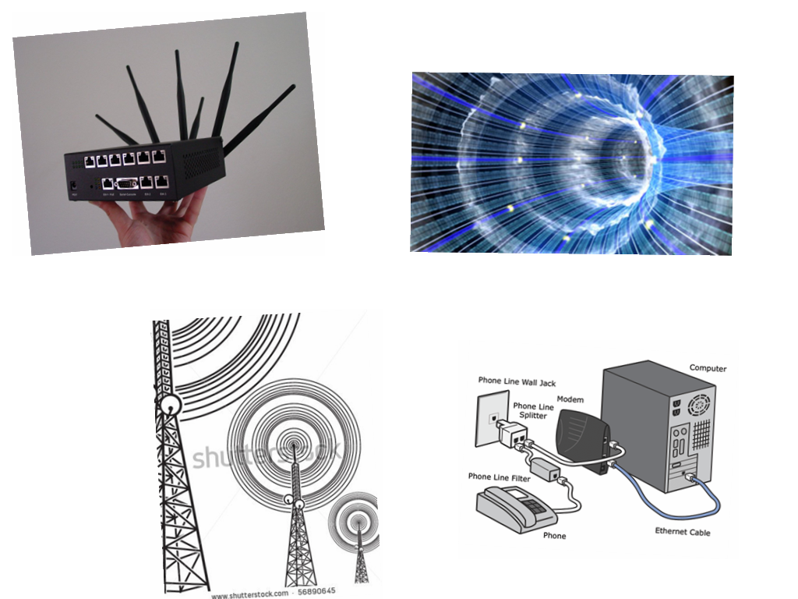
High BW- Options

Slide 6
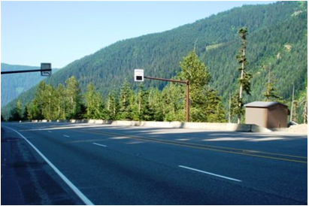
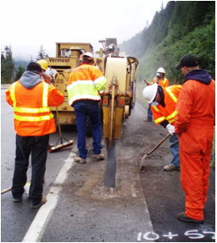
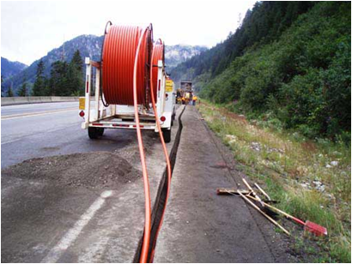
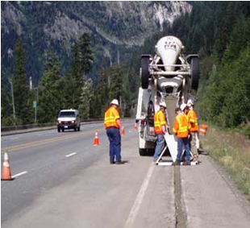
With Fiber – steps to install
1
Electronic Signage Two variable speed limit signs installed
2
This special machine cut the trench for the new fiber cable directly through the existing pavement.
3
After it was installed on the south shoulder of US 2, the fiber optic cable was buried.
4
Paving over the fiber cable trench

Slide 7


Fiber is …
But Sunk Cost as they cost US $100000-$200000/km in metropolitan areas, with 85 percent of the total figure tied to trenching and installation.[1]

Slide 8

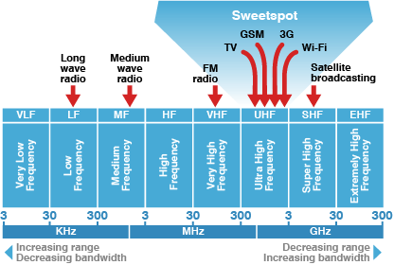
Why not RF?
Immense capital investment
To acquire RF spectrum

Slide 9
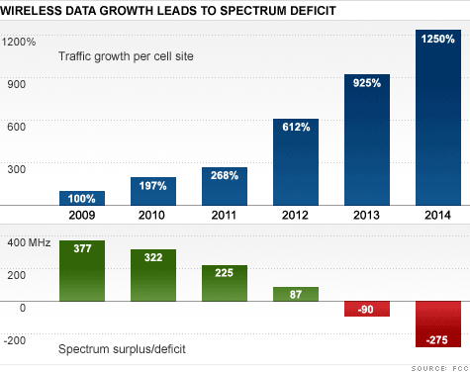
BW- Endangered
Bandwidth is becoming an endangered species, so to speak, and carriers are running out of airwaves to cram data into.
The Federal Communications Commission has said that a current wireless spectrum surplus of 225 MHz will become a deficit of 275 MHz in about 2 and a half years.

Slide 10

With DSL Lines

Slide 11
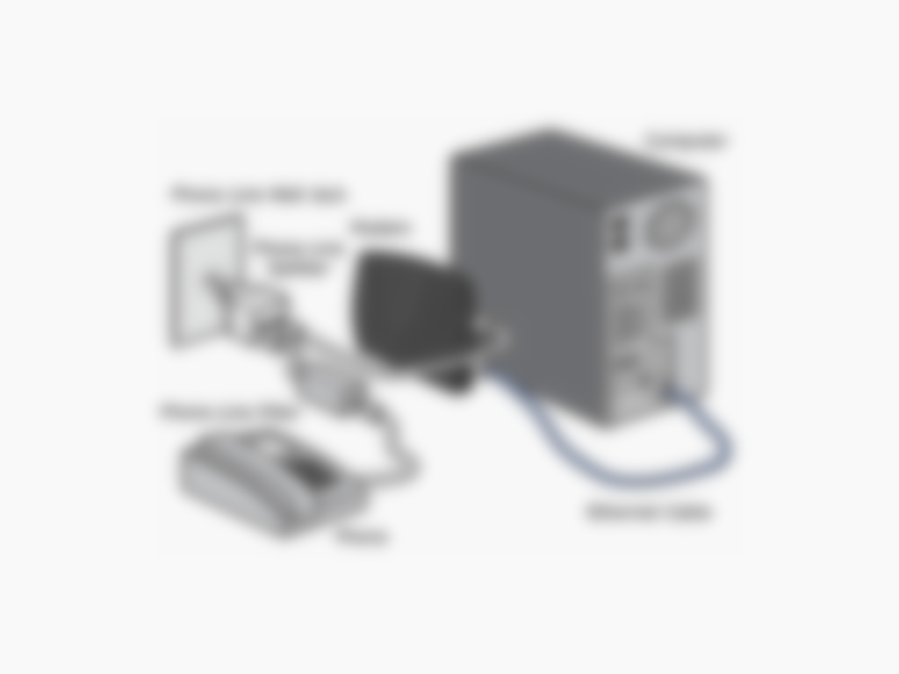
With DSL Lines

Slide 12
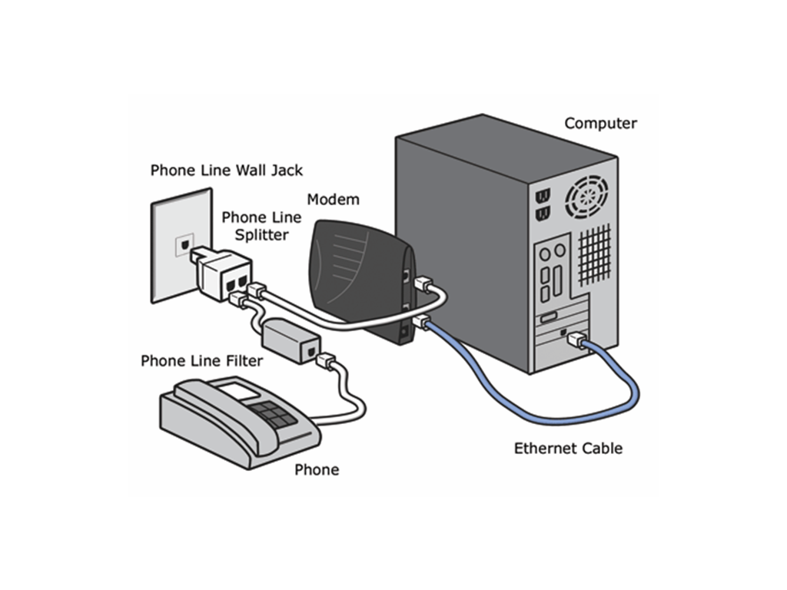
With DSL Lines

Slide 13
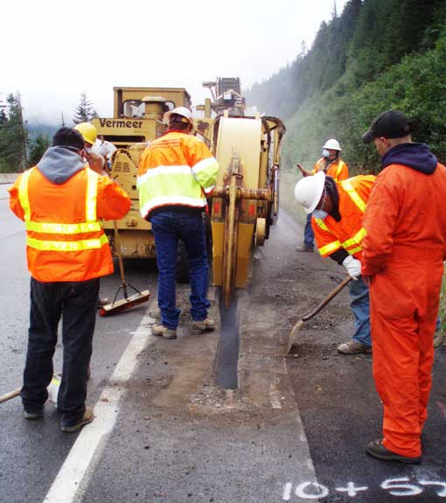

With FSO
No trenching
No licensing above 300 GHz

Slide 14

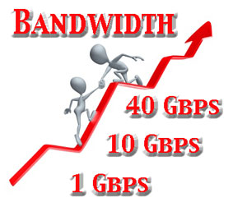
Advantages
Higher bandwidth
Low Cost-These free-space systems require less than a fifth the capital outlay of comparable ground-based fiber-optic technologies[2]

Slide 15
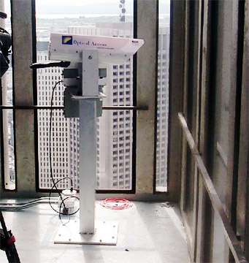
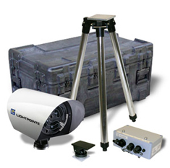
Faster Installation

Slide 16

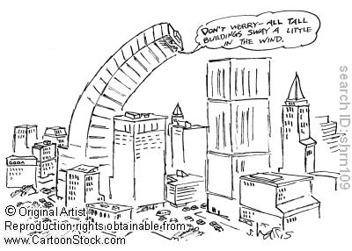
Limitations
Atmosphere dependent
Swaying buildings

Slide 17


Limitations
Eye safety
Small range

Slide 18
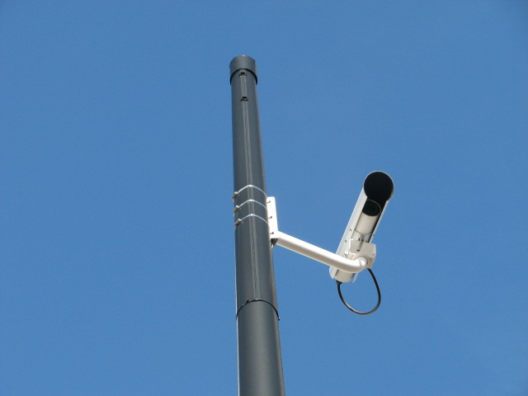
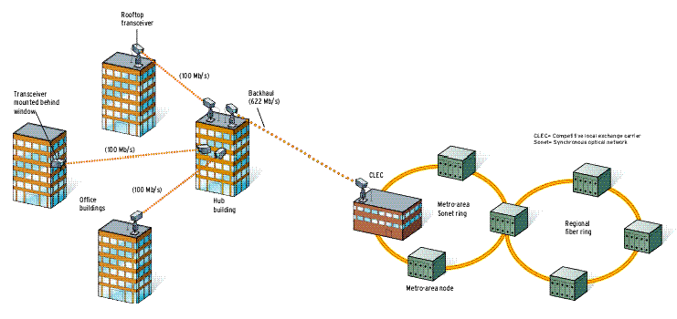
Applications
Last mile connectivity
CCTV

Slide 19
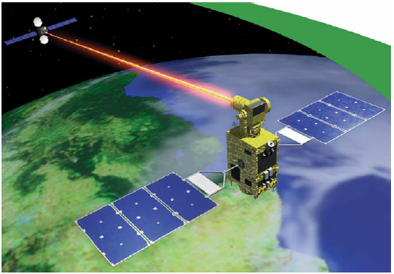
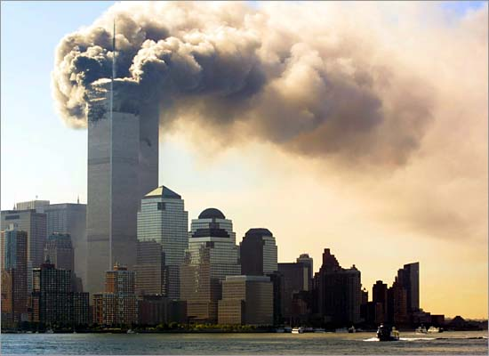
Applications
Satellite communication
Disaster recovery

Slide 20
TRANSMITTER

Slide 21
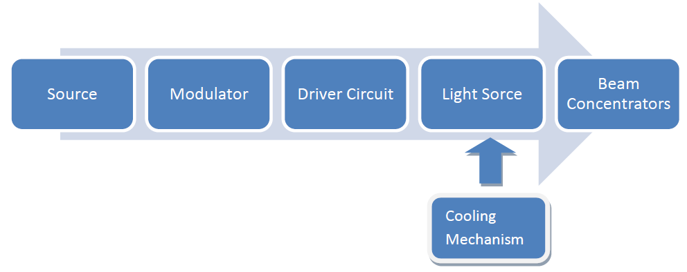
Transmitter Block Diagram

Slide 22
Incoming Signal
Can be LAN signal arriving via RJ-45 cable to be entered via Ethernet kit for interfacing with transceiver.
Can be RS232 signal to be converted to TTL or CMOS compatible using MAX232 IC.
HyperTerminal to be used for serial communication via RS232.

Slide 23
Light Sources
42 artificial sources of light.
16 of them combustion based (lanterns)-too slow.
4 e⁻ simulated emission (CRT)-not directional.
5 incandescent light source (halogen)-too high power.
13 gas discharge lamps-need ballast to control light emission and are bulky.
3 electroluminescent sources – LEC’s , LED, electroluminescent wires.
LASERs.

Slide 24
Source Requirements
Frequency response of the light source must exceed the frequency of the input signal as light is the carrier.
The light source should launch its energy at angles that maximum portion is transmitted to receiver end.
Faster speed of operation.
Long lifetime.
Frequency of operation in Terahertz range (800-1700 nm).
Reasonably monochromatic (small spectral width).
Temperature stability.

Slide 25
LED v/s LASER
LED
LASER
Non-coherent.
Few MHz.
Eye safe.
Preferred for indoor applications.
Optical power output.
Coherent Beam.
Up to 10 GHz.
Classes I,II,III.
All practical outdoor FSO systems require LASER.

Slide 26
LED v/s LASER

Slide 27
Types of LASERs
Diode laser.
Helium-Neon laser.
Argon/Krypton ion laser.
Carbon Dioxide laser.
Helium-Cadmium (HeCd) laser.
We use LASER diode as it is small in size, easy to handle, cost effective, electrically run and easily available as it is used in fiber optics.

Slide 28
Classes of LASERs
Class 1: Inherently Safe.
Class 2: Safe as aversion of eye prevents damage.
Class 3: Unsafe even when reflected.
We use red laser as near infrared (780 nm) and higher wavelength up to 1550 nm has lower attenuation.
Class II lasers with power up to 5mW as per range requirement are used.
When using LED, IR LED is used due to lower attenuation.

Slide 29
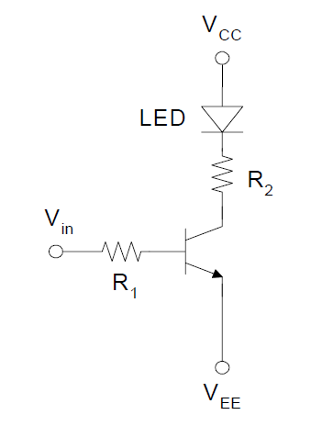
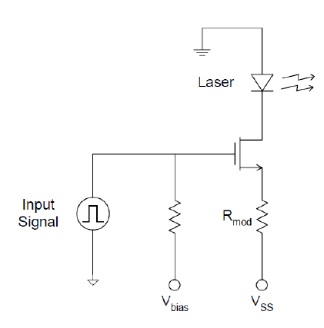
LED Driver

Slide 30
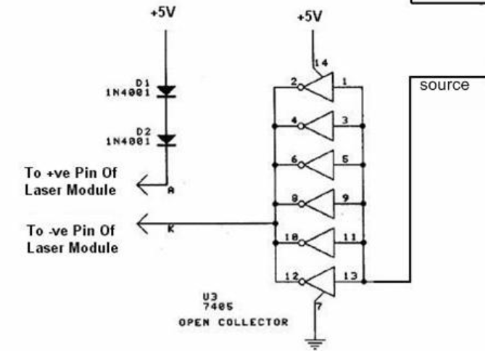
LASER Driver

Slide 31
Modulation
Occurs at 2 levels- incoming signal modulating carrier and combined signal modulating light.
Intensity modulation /Direct Detection the most popular.
Conventionally, analog modulation was used. FM better than AM in analog schemes.
Then started pulse coded modulation by sampling the analog signal.

Slide 32
Analog Modulation
Electrical signal modulates carrier and modulated signal modulates light carrier.
FM preferred over AM due to :
additive noise.
Frequency shift from unwanted illumination.
PAM,PWM,PPM,PCM and then intensity modulation also possible.
PPM highly favoured due to high power efficiency.

Slide 33
Digital Modulation Techniques
FSK, PSK & ASK – digital signal .
OOK.
Variants- RZ and Manchester.
Using Block encoding L-PPM.
power efficiency of OOK is inferior to PPM.
OOK encoding is more commonly used.
Reason is efficient bandwidth usage and robustness to timing errors.

Slide 34
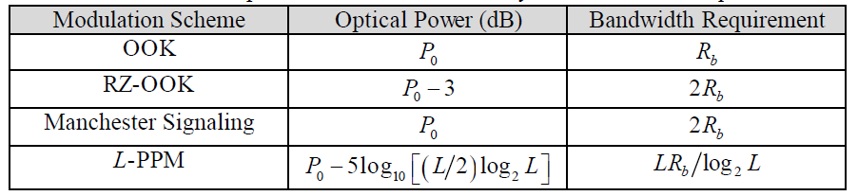
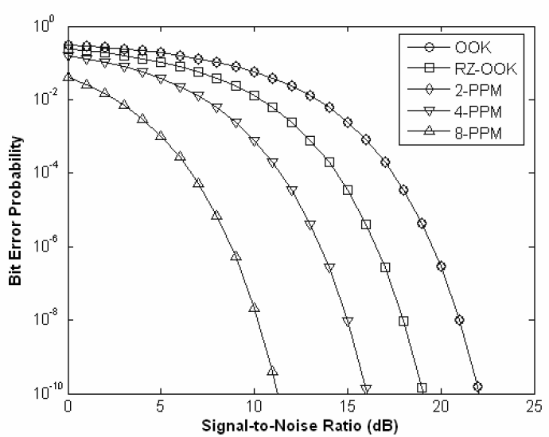
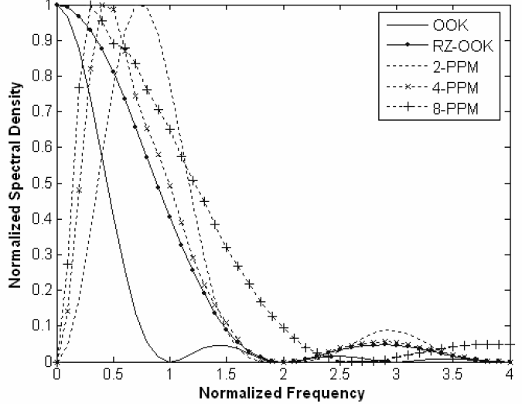
Digital Modulation schemes comparison
-DESIGN AND ANALYSIS OF ADVANCED FREE SPACE OPTICAL COMMUNICATION SYSTEMS ,Sugianto Trisno, Doctor of Philosophy, 2006

Slide 35
Receiver

Slide 36
Optical Receiver Block Diagram

Slide 37
Photo detector - requirements
High responsivity.
Low internal noise.
Sufficient bandwidth.
Insensitivity to external conditions.
Linearity.
Cost effective, reliability, high stability, small size.

Slide 38
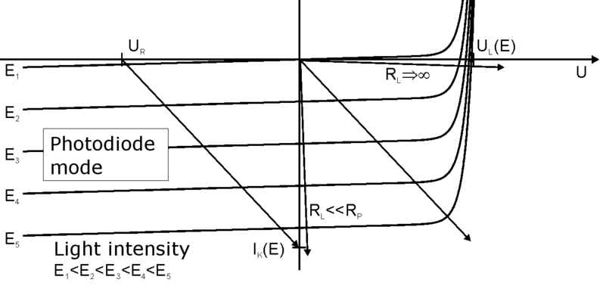
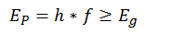
Photo diode – working principle
Light(photons) incident on material.
If
Then electron emission.
Free electron – current generated.

Slide 39
Link Margin
If it is desired to calculate a link margin for a link, rather than relying on the experience of the vendor or industry guidelines, this formula can be used.
P = power,
dr = receiver aperture diameter in meters,
dt = transmitter aperture diameter in meters,
D = beam divergence in mrad,
R = range in kilometers,
a = atmospheric attenuation factor in dB per kilometer.

Slide 40
Why Photo Diode ???
Mainly 3 types of photo detectors,
Photo Multiplier – Capable for low noise and high gain but, large size and high voltage requirement makes it unsuitable.
Pyroelectric detectors – can detect high speed laser pulse but, quite flat response over broad spectral band, less durability and less accuracy than thermopiles or photodiodes, sensitivity to vibrations and can't measure continuous light nor long pulses.
Semiconductor based photodiode - photo diodes are mainly used because of its small size, fast response time and high sensitivity over photo transistors.

Slide 41
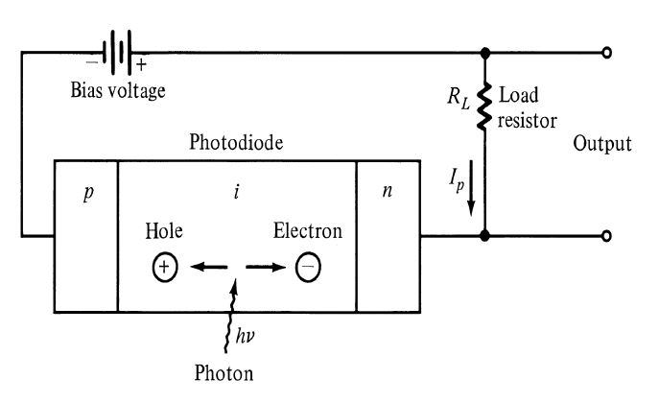
PIN photo diode

Slide 42
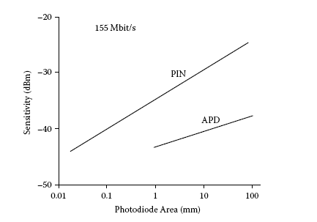
PIN v/s APD
APD has gain of avg. 10 dB in sensitivity than PIN photodiode.
Responsivity,
PIN : 0.5-0.7 µA/µW.
APD : 30-80 µA/µW.
PIN is used widely in indoor application, because of the cost factor only.

Slide 43
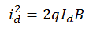
Noise in receiver
Mainly 3 types of noise.
1. Dark current noise,
2. Quantum noise,
3. Thermal noise,
Narrow band pass filters used to reduce the noise.

Slide 44
Pre - amplifier
3 types of pre-amplifiers,
1. Low-impedance amplifier.
2. High- impedance amplifier.
3. Trans- impedance amplifier.
3 parameters to choose particular amplifier –
noise, bandwidth and sensitivity.
Load resistance play an important role.

Slide 45
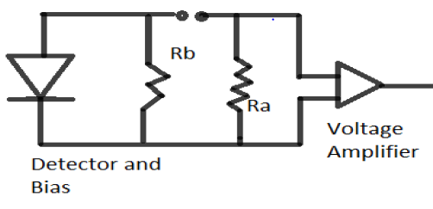
Pre - amplifier
1. Low impedance pre-amplifier,
High bandwidth is hindered by
high noise and low sensitivity.
2. High impedance pre-amplifier,
Has same figure as low impedance amplifier.
Can be used at narrow band application, but not at wide band application – due to low bandwidth.

Slide 46
Pre - amplifier
3. Trans impedance pre-amplifier,
Uses feedback resistance.
More bandwidth as well as more sensitivity.
Most preferred.

Slide 47
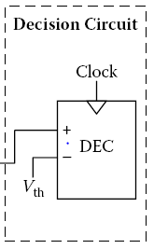
Decision circuitry
Binary digital circuit.
Compared a threshold value with a sample value to take decision.
Triggered using a clock to synchronize.
Forward error correction and adaptive equalizer in order to improve performance.

Slide 48
Transceiver Design

Slide 49
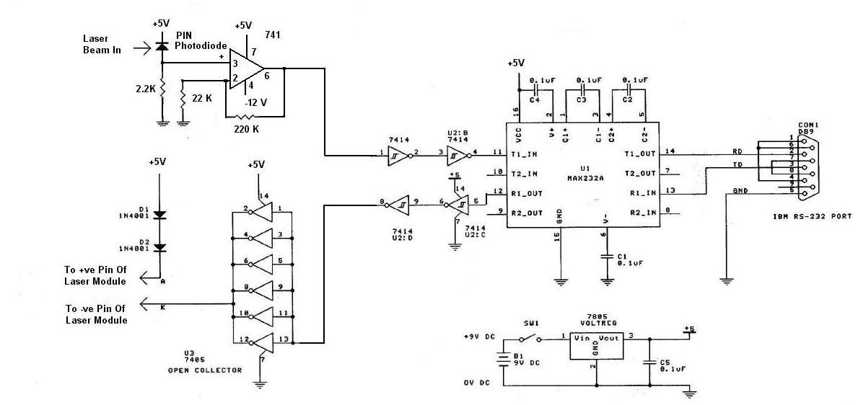
Transceiver Circuit Implemented

Slide 50
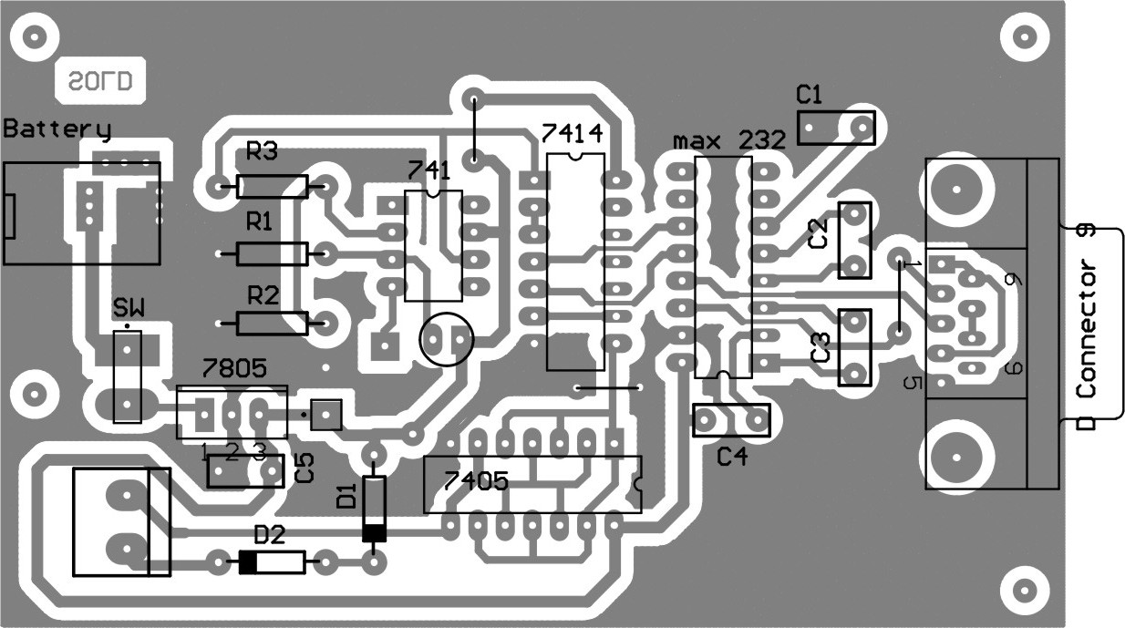
Layout of Transceiver Circuit

Slide 51
Transceiver Design Specifications
IC used –
max232 – Driver of RS232(serial port).
- Uses dual charge pump voltage converter.
7405 – For laser diode driver(35 mA @ 3V).
7414 – Hex inverter with Schmitt trigger.
- Sharper Response.
741 – OPAMP, with gain 10 for received signal.

Slide 52
Transceiver Design Specifications
Components Used –
PIN Photo Diode – BPW – 34
- 600 nm to 1050 nm
1N4007 – gives 3.4 V to laser diode
7805 – constant 5 V to whole circuit
Laser diode – red laser, 670 nm, Class II, on-off keying modulation
RS232 port – serial port for communication

Slide 53
Working Process
Transmitter part:
Digital devices - CMOS/TTL logic based, device is connected to a RS232 port and its voltage levels are converted to 0 & 5 V using max232.
Passed through 7414 for Schmitt triggering.
LASER driven through 7405 for current requirement.
Receiver part:
Light detected using BPW34, then amplified using 741.
Sent to RS232 via max232 for voltage converter.

Slide 54
Channel Model

Slide 55

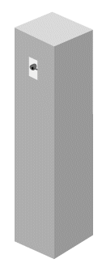


Environmental factors
Sunlight
Window
Attenuation
Fog
Building Motion
Scintillation
Alignment
Range
Obstructions
Low Clouds

Slide 56
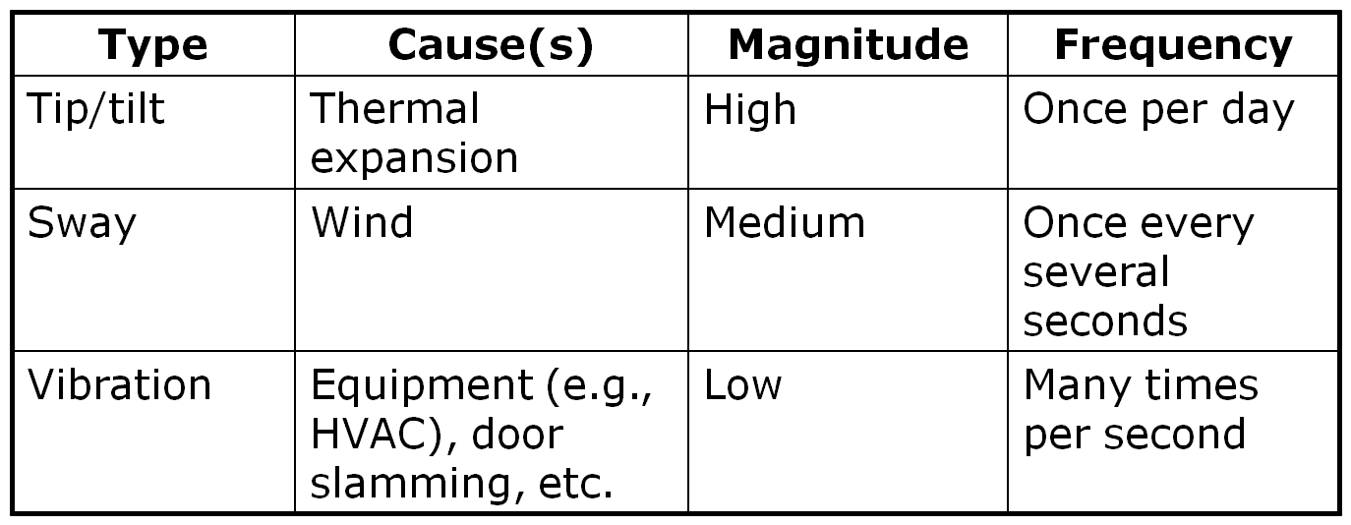
Frequency and magnitude of causes

Slide 57
Four different Channel Models
Lognormal
Gamma-gamma
K
I-K
Channel Model | Turbulence scenario | Limitation
Lognormal | Weak | High turbulence
Gamma-gamma | Weak to strong | Computation Complexity
K | strong | Low turbulence
I-K | Weak to strong | -

Slide 58
Lognormal channel model
Weak turbulence scenario (S.I<0.75)
For distances less than 100 m
2 methods:Gauss–Hermite quadrature approximation and based on power series for BER calculation.
Gauss–Hermite is an approximation
Power series:- Perfect

Slide 59
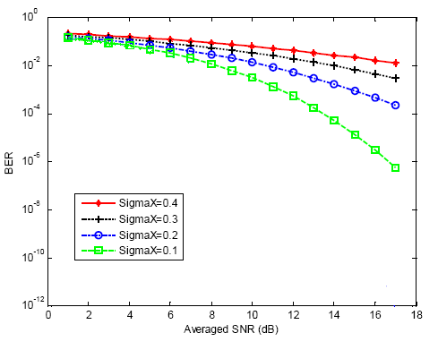
Numerical Solution
Where SigmaX= fading intensity

Slide 60
Imperfect CSI
Don’t have channel knowledge
Don’t know the value of η
Can’t predict transmitted symbol from received symbol
Can’t use conventional channel models

Slide 61
Gauss-Markov model
Carl Friedrich Gauss and Andrey Markov
Gives best estimation of the channel
Result based on previous bits received and ML theorem
δ is the correlation factor which varies between 0 to 1. 0 means totally uncorrelated while 1 means purely related to actual value
h is fading co-efficient
w is white Gaussian noise of channel.

Slide 62
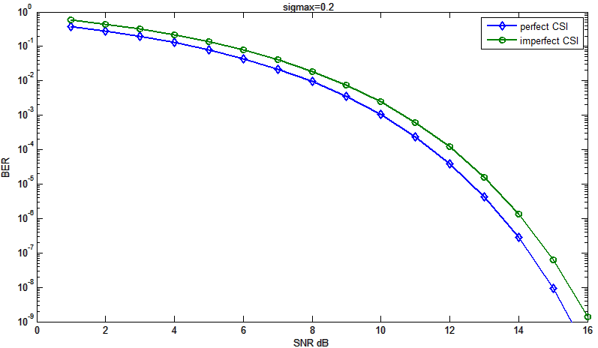
BER analysis for Lognormal : Perfect Vs imperfect

Slide 63
Gamma-Gamma channel model
Covers all regimes from weak to strong turbulence
Pdf can be directly related to atmospheric condition
Lognormal channel model is only applicable to weak turbulence conditions
As the strength of turbulence increases, multiple scattering effects must be taken into account , lognormal statistics exhibit large deviations compared to experimental data.
Lognormal pdf underestimates the behavior in the tails as compared with measurement results.
Since detection and fade probabilities are primarily based on the tails of the pdf, underestimating this region significantly affects the accuracy of performance analysis.

Slide 64
Future Work
Test the hardware for datarate and functioning in different environmental conditions.
Place a proposal for FSO link between blocks of the institute.
Study IEEE papers and present paper based on channel performance or modulation technique.

Slide 65
References
FreeSpaceOptic.com
Fiber optics without fiber, BY HEINZ A. WILLEBR AND & BAKSHEESH S. GHUMAN,LightPointe Communications Inc. IEEE Spectrum, Aug,2001
OPTICAL WIRELESS COMMUNICATION, by Roberto Ramirez-Iniguez, Sevia M. Idrus, Ziran Sun.
Understanding the performance of free-space optics by Scott Bloom, AirFiber, San Diego, California, Eric Korevaar MRV Communications, FSO Division, Chatsworth, California
DESIGN AND ANALYSIS OF ADVANCED FREE SPACE OPTICAL COMMUNICATION SYSTEMS Sugianto Trisno, Doctor of Philosophy, 2006
Free Space Optics in Next Generation Wireless Networks,Technology Digest, monthly bulletin of telecom technology, Issue 8, February,2012
J.M. Senior, Optical Fiber Communications: Principles and Practice, 2nd ed. Prentice Hall International, 1992.
D.C. O’Brien, G. Faulkner, K. Jim, E. Zyambo, D.J. Edwards, M. Whitehead, P.N.Stavrinou, G. Parry, V.M. Joyner, R.J. Samsudin, D.M. Holburn, and R.J. Mears, High-Speed Integrated Transceivers for Optical Wireless, IEEE Communications Magazine, 41(3), 58–62, 2003
Sinah, J. John, Y.N. Singh, and K.K. Tripathi, Design Aspects of High-Performance Indoor Optical Wireless Transceivers, presented at IEEE ICPWC2005, New Delhi, 2005, pp. 14–18
L. Matthews and G. Garcia, Laser and Eye Safety in the Laboratory. in SPIE Press, IEEE Press,1995.
Fso.net
Lightpointe.com

Slide 66
Thank You

